Slide 1
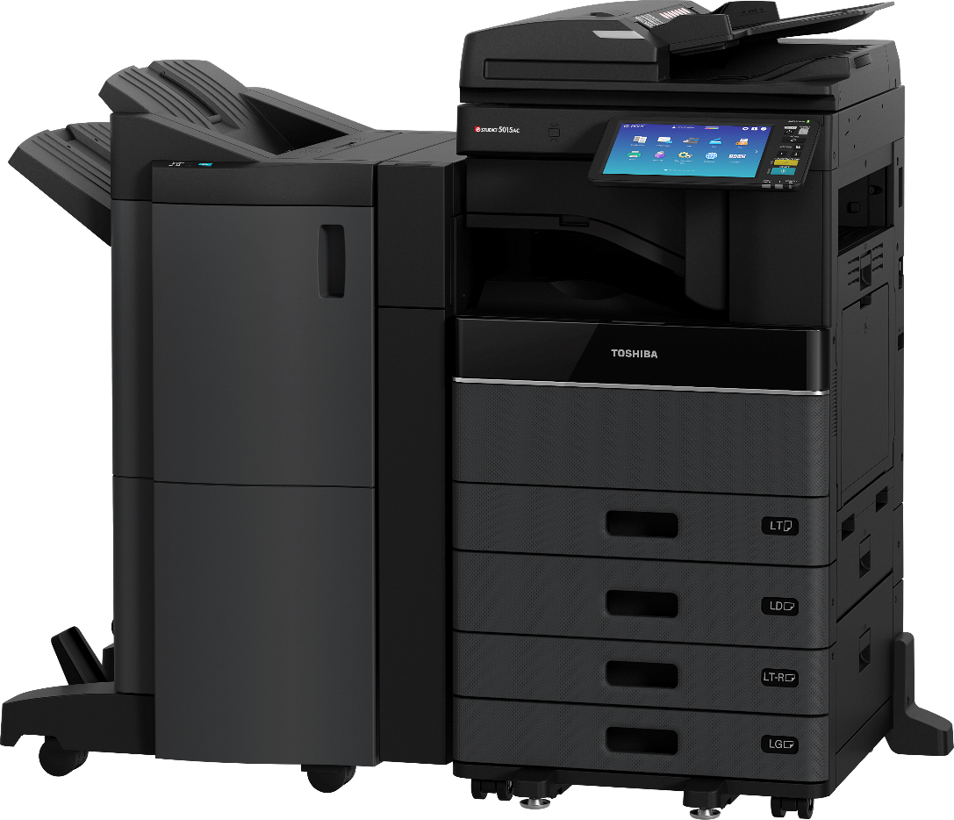
Product Overview
Presented By:

Slide 2
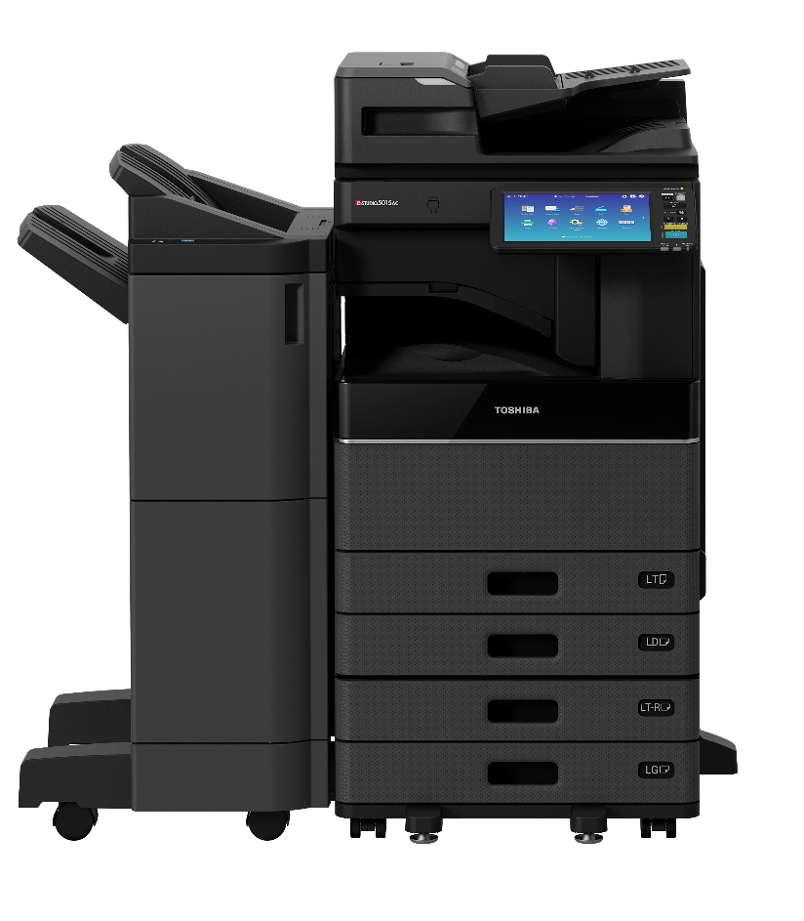
Agenda
Introduction to New Product Line
Positioning & Target Markets
Specification & Feature Highlights
Cloud-Based Applications
Security & Environmental Highlights
Summary

Slide 3
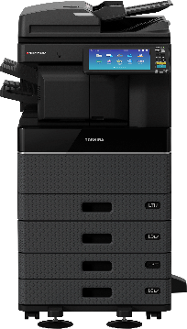
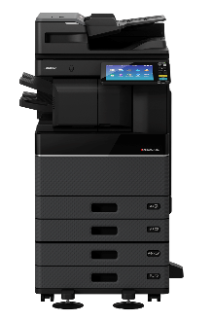
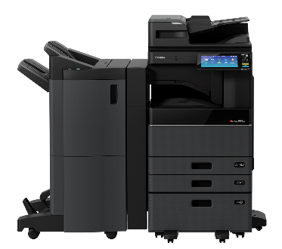
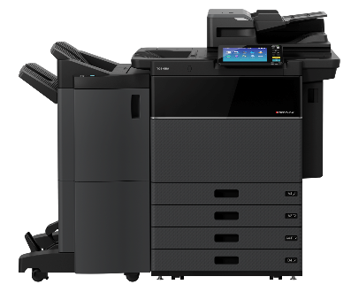
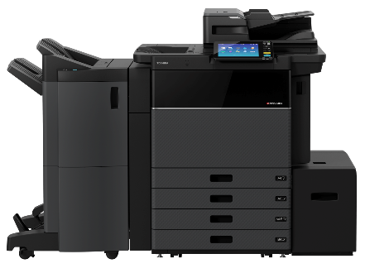

20 New Models!
Introduction to New Product Line
Based on similar platforms
Based on similar platforms
Launched August ‘18
Launching in December ‘18

Slide 4
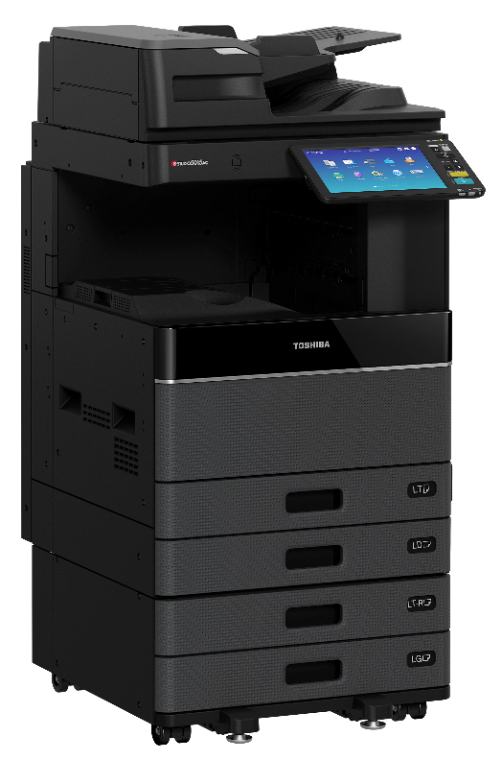
Introduction to New Product Line
Model Numbers
Engine Family
New Suffix – “Advanced”
Generation
Color
Speed (PPM)
e-STUDIO5015AC Series
Category |  | Engine Family ID #
Low Speed Models | Color | 0
 | B&W | 3 / 9 / 2
Mid / High Speed Models | Color | 5
 |  | 6 / 7
 | B&W | 8
50 PPM 2nd Generation Advanced Color

Slide 5
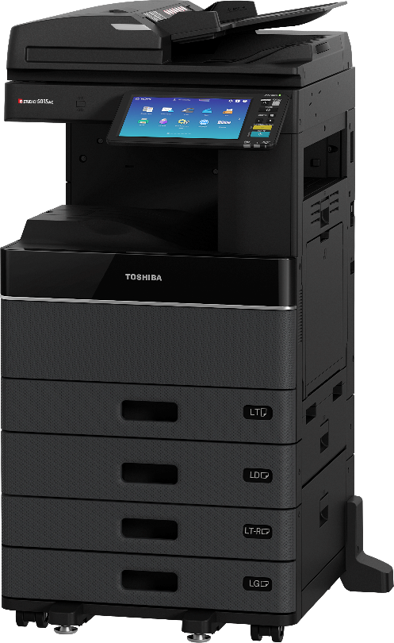
Introduction to New Product Line
20 – 50 PPM Full-Featured Color & Monochrome MFPs
Copy, Print & Scan std. Fax optional
Contemporary Styling!
Proven Technology
Competitive Specifications
New User Interface
High-Speed Dual Core Processor
New Features

Slide 6

Introduction to New Product Line
6
These three model families below are built on essentially the same platform, but do have some significant differences. This table highlights the key differences.
Models (ppm) | 20, 25 | 25, 30, 35, 45, 50 | 20, 25, 30, 35, 45, 50
Color/Mono | Color | Color | Mono
Laser/LED | LED | Laser | Laser
Doc Feeder opts. | RADF only | DSDF/RADF | DSDF/RADF
12”x18” & Banner | No | Yes | No
# drws/std. cap./max | 1/350/2,900 | 2/1,200/3,200 | 2/1,200/3,200
Paper options | Full Array | Full Array | Full Array
Finishing options | Limited | Full Array | Full Array
Web Browser(EWB) | Opt. | Std. | Std.

Slide 7
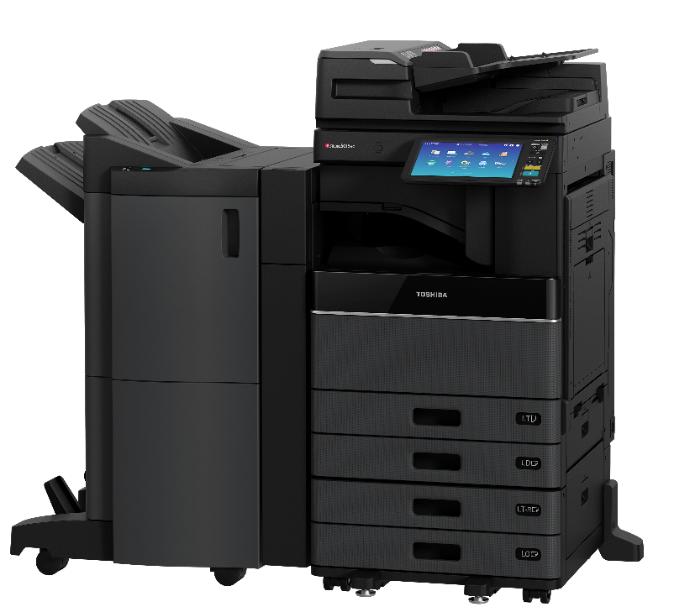
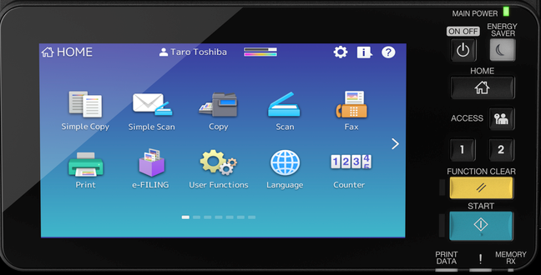
Positioning
Mid-volume 20 – 50 PPM, full-featured Color & Monochrome MFPs for business users that want exceptional image quality and workflow-enhancing solutions to improve their overall productivity

Slide 8
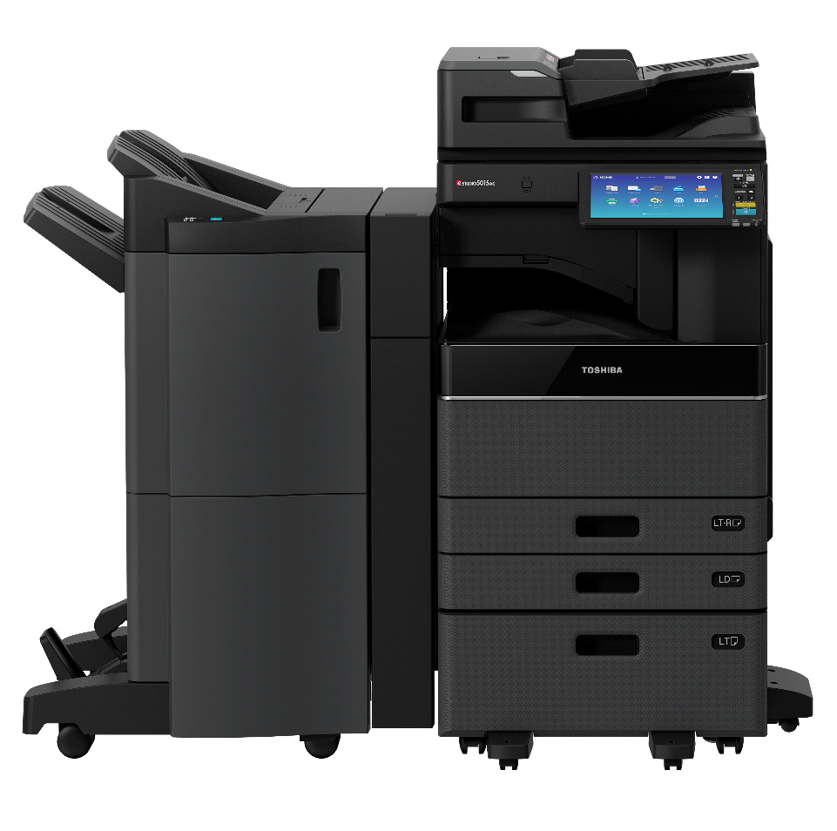
Target Markets
Small to mid-size businesses
Real-estate, Healthcare, Financial
Workgroups in larger businesses
Manufacturing, Logistics

Slide 9
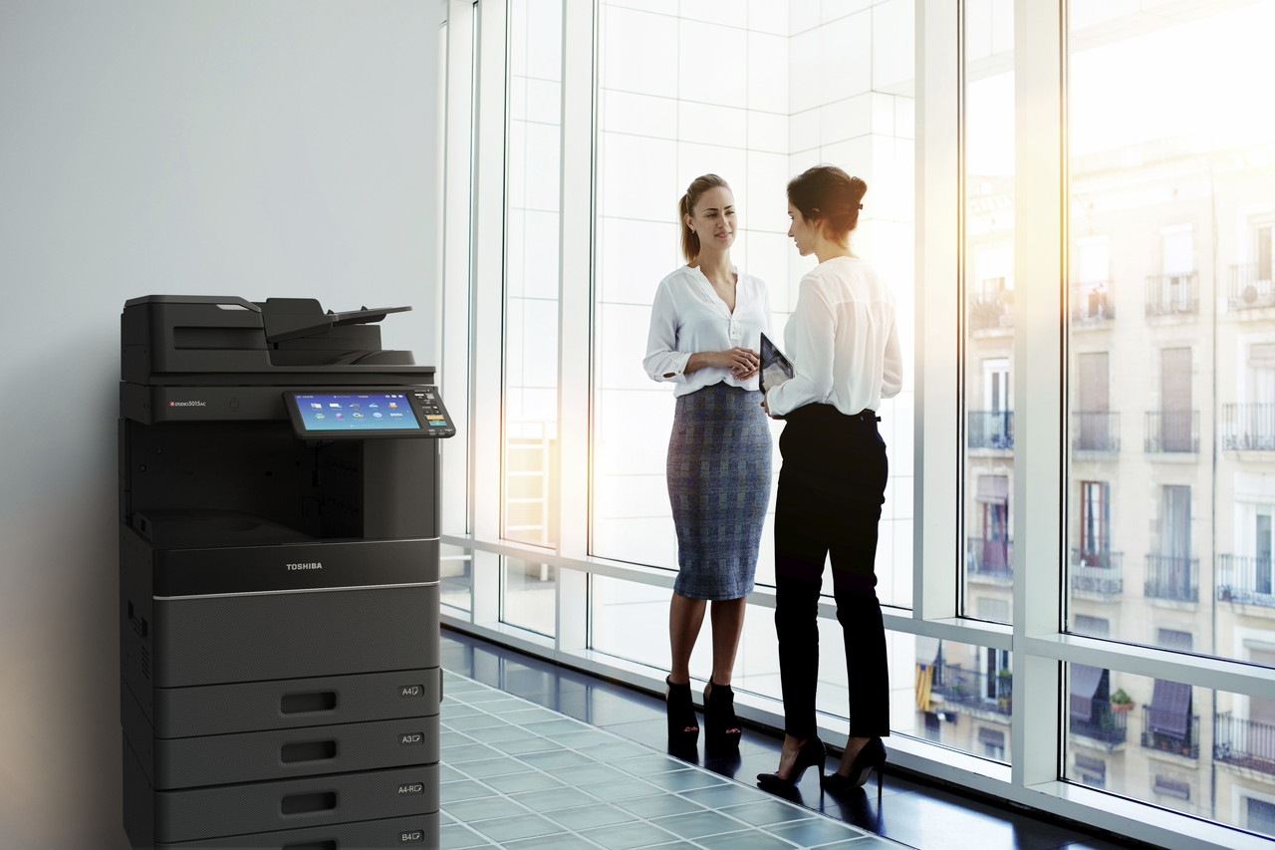
Contemporary Look
Modern Styling
Advanced U/I
Leading Technology

Slide 10
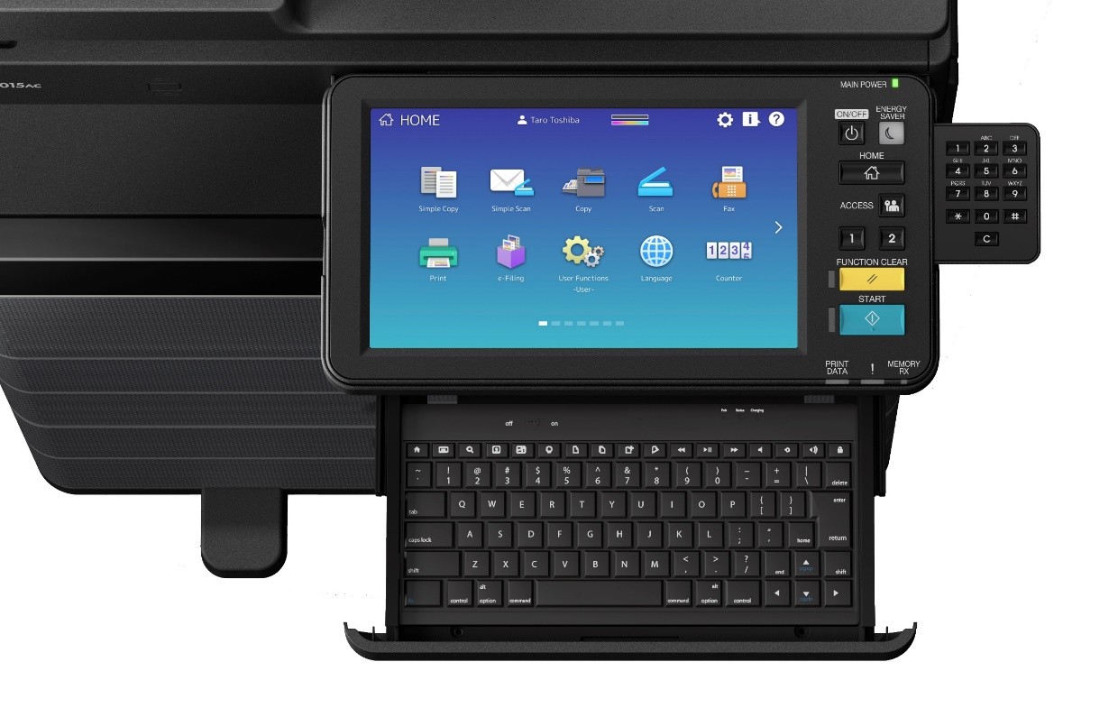
10.1” Tablet Style UI
Customizable
Optional Accessory Tray
Optional 10 Key
More than 25% Larger!
Notes:
The first thing people notice on these models after their stylish look is the new 10.1” touch-swipe front panel that is consistent with your smartphones and gives you over 25% more area over the previous line.
And it’s customizable too. There’s also an accessory tray that can house a Bluetooth wireless keyboard and there’s an optional 10-key, but neither of these are required. They’re just a convenience.

Slide 11

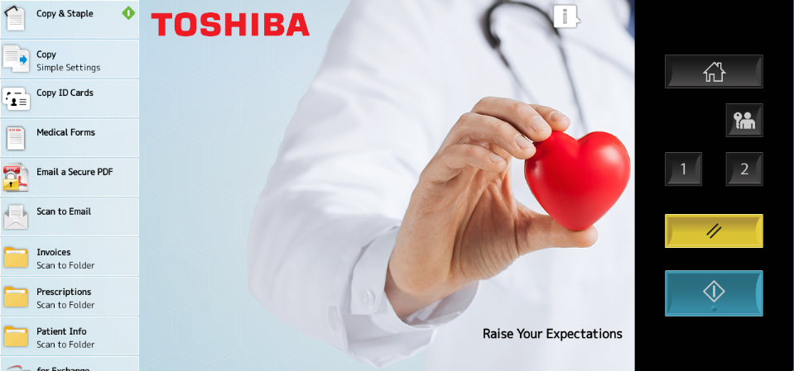
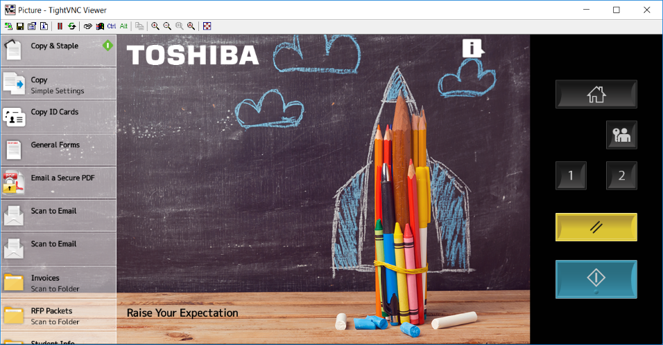
Ideal for Routine Tasks
Customizable
Improve Productivity
Streamline Workflow
Minimize User Error
Notes:
Those with more specific task-oriented routines will appreciate the latest customizable version of the Elevate UI. It simplifies the menu structure even further, improving productivity and minimizing user errors. The concept behind Elevate is to consult with end-user and identify their most consistent tasks and clear the panel of everything but those. So whether your doctor’s office or a school, you’ve got the functionality you need, right at your fingertips.
This is a fantastic approach for departments that perform consistent tasks on the MFP and need to get that task done and get on with their job.
I encourage you to take a closer look at this at our product fair. There’s even a break-out session right after this one that takes a deeper dive at this unique approach.

Slide 12
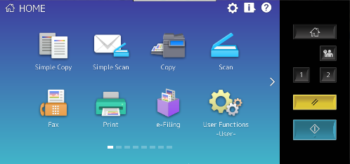
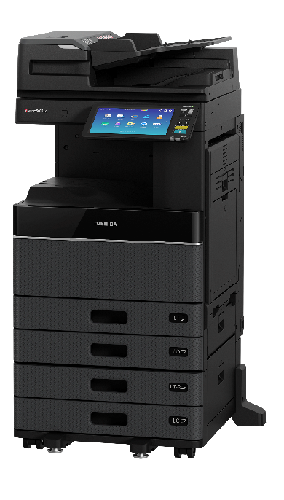
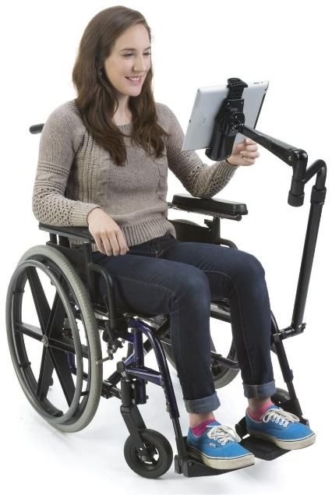

Location Free Panel
Access/Control MFP Remotely
Including Hard Buttons
Use Tablet or PC
Ease-of-Use for the Disabled
Use VNC Viewer App
Notes:
While we’re talking about the UI, I’d like to mention our new Location Free Panel. This uses VNC or Virtual Network Computer technology to enable users to control all aspects of the MFP remotely from a PC or tablet. Even the hard buttons or those not on the LCD itself can be controlled. This has huge implications for handicapped users that maybe can’t easily reach the built-in front panel – even though it does tilt just for that reason. Right now I’d like to show you this from my handy iPad that I’ve brought along. For this I’d like to engage a user from the audience.

Slide 13
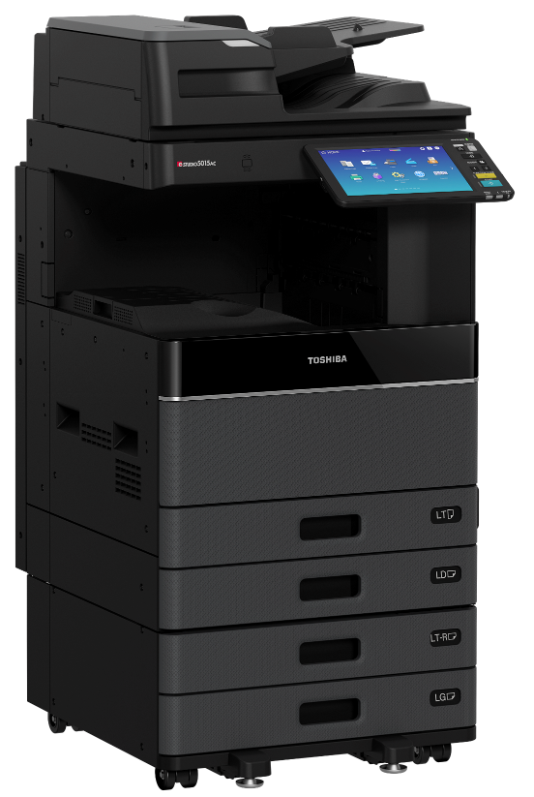
Dual Scan Document Feeder
300-Sheet Capacity (Refillable)
Scans Up to 240 IPM Duplex
120IPM Simplex
Notes:
So, getting back to the hardware, I want to brag a little bit. A key part of a digital MFP is the document feeder and businesses that do a lot of copying and scanning will appreciate our Dual Scan Document Feeder. This DSDF holds 300 originals, is refillable and scans at an amazing 240 duplex impressions per minute. I assure you, we’ve got the strongest specs in the industry.
This DSDF is standard on our 55+ monochrome and color models where it’s all about productivity, but optional on our midrange models.

Slide 14
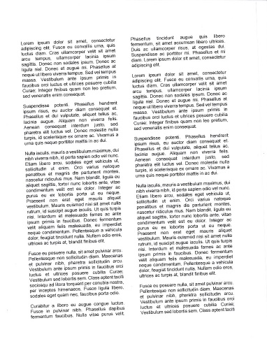
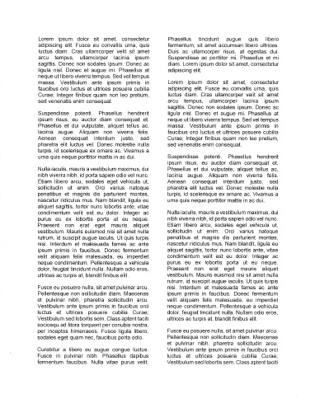
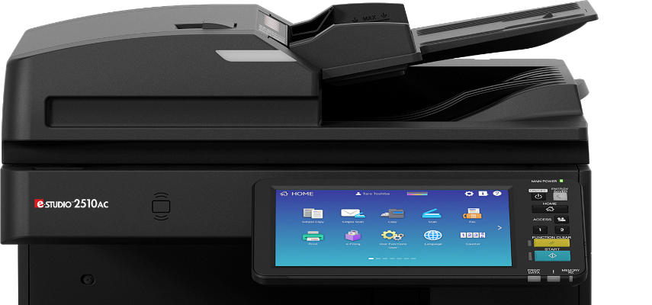
De-skew Technology
Keeps Image Aligned on Page
Works with DSDF or RADF
Original Scan
De-skewed Page
Notes:
And on these new models we’ve incorporated De-skew technology that ensures the scans are aligned perfectly even at speed. Software within the MFP analyzes each scanned page to make the determination and if necessary applies de-skew logic behind the scenes. This was never an issue before, but I have seen it be a requirement in some major account bids. Now you’ve got it.

Slide 15
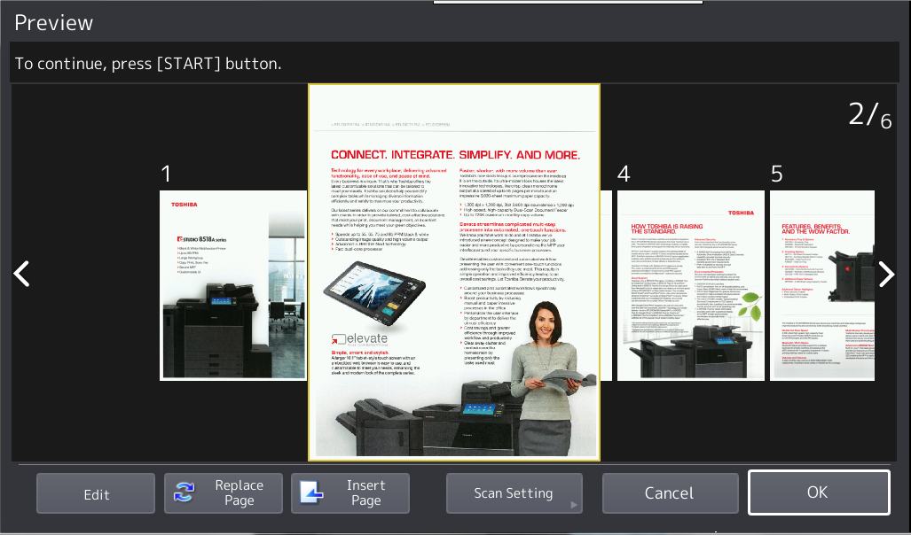

Enhanced Scan Preview
Preview Images Before Saving
Rotate Pages
Change Order
Notes:
Speaking of scanning, we’ve added a scan preview feature that now allows a user to preview their scanned document before committing it to file, and even rotate pages and change their order.
This can be really handy if you want to review what you’ve got at the MFP and make any adjustments while you’re right there.

Slide 16
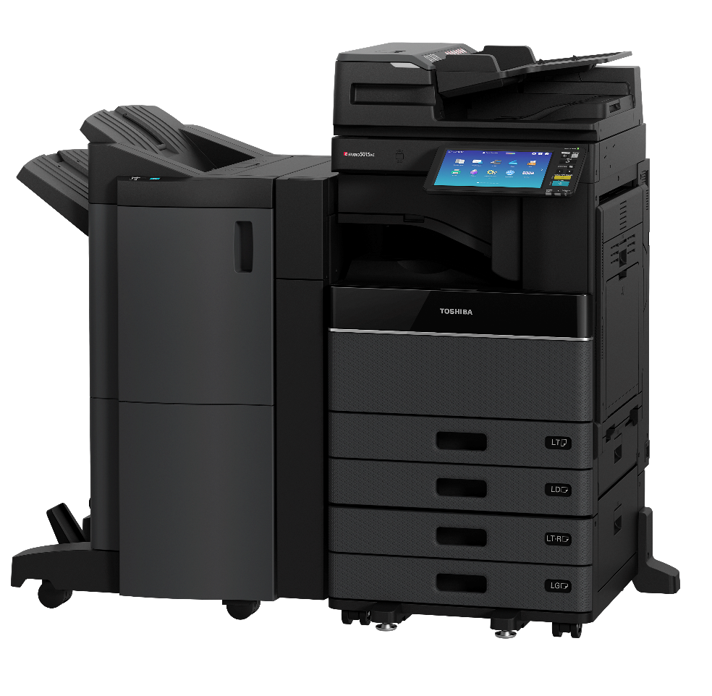
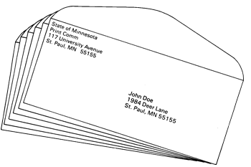
Media Range Support
Large Sizes, Heavy Weights
Banner Stock 12” x 47”
Custom Paper Size
Envelope Support
Notes:
I want to take a quick moment and talk about media-range support. Let me just say this is another area where Toshiba got it right. I can say this with confidence because the paper handling was proven on the previous models. The minimum and maximum paper weight is among the widest I’ve ever seen, as is the minimum and maximum paper size. The mid-range and high-end models can take 12”x 18” in the cassettes and the high-end models can even take 13” x 19” through the bypass.
And these new models support custom paper size in the cassettes and have automatic paper size detection. They can now even duplex that custom-size paper. I encourage you to approach your restaurant customers and tell them you’ve got an MFP that can print their menus now. This is who was asking for it.

Slide 17
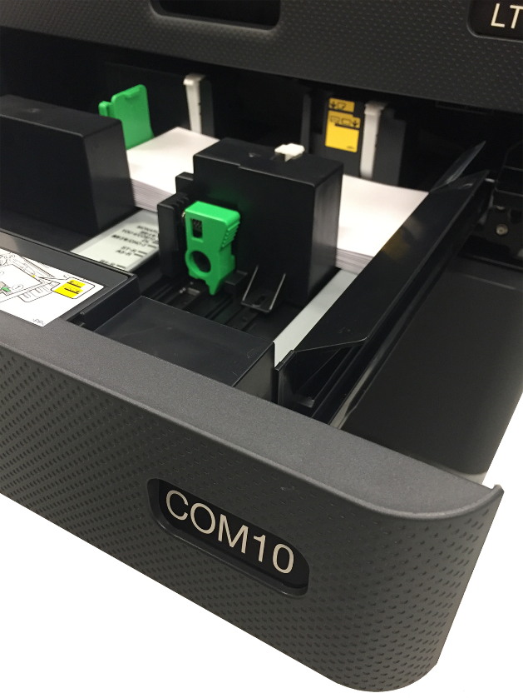
Feature Highlights
Envelope Drawer (MY1049)
Holds ~ 60 Envelopes (~2” stack)
Supports Comm 10 & other popular sizes
Or Holds 550 sheets of LT-R – LG
Requires Paper Feed Pedestal (KD1058)
Fits in Drawer 3 or 4

Slide 18

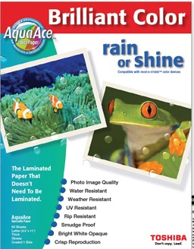

AquaAce Media Support
Waterproof & Tear Resistant
UV & Weather Resistant
Acts as Laminated Media
Available in Banner & Other Sizes
47”
12”
Notes:
Speaking of specialty stock, these models support our unique Aqua-Ace media available in a variety of sizes including a 12” x 47” Banner size. This laminated, UV resistant, waterproof paper opens the door to so many applications. Consider how you might be able to use it. I encourage you to show this to your customers because it really opens the door to a lot more uses for the MFP.

Slide 19
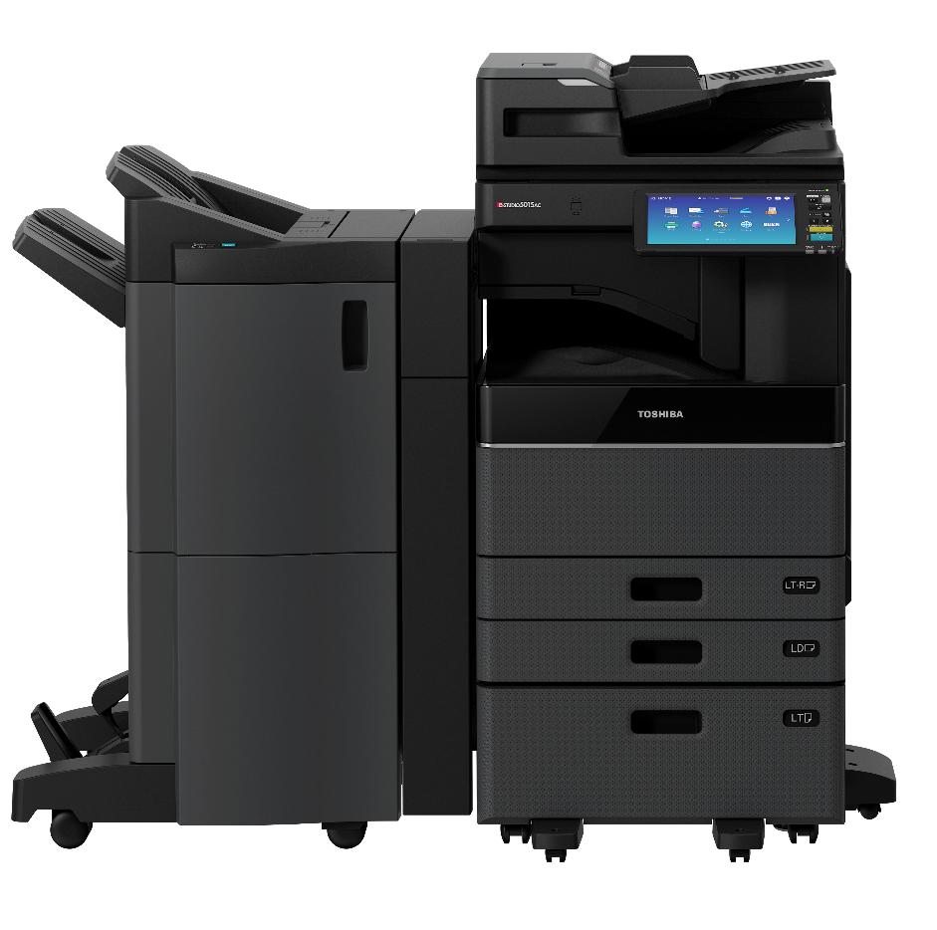
Maximum Monthly Copy Volumes
Model Family | MCV
 | Up to 84K
 | Up to 150K
 | Up to 210K

Slide 20
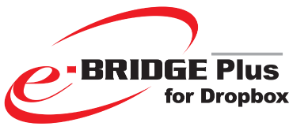

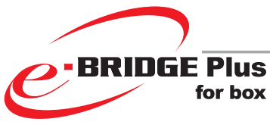

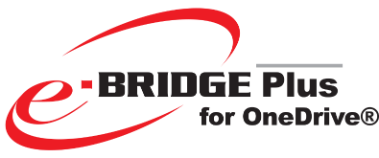

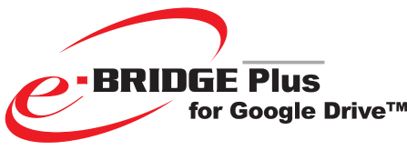

Cloud-Based Apps
Send Documents to the Cloud
Use MFP as Onramp
Connectors for Most Popular
Notes:
I don’t have to tell you that cloud-based document storage is where it’s at. Can I see a show of hands here of who has a DropBox account? How about Box? Google Drive? Microsoft One Drive? These are just some of players.
These new e-BRIDGE MFPs with the high-speed DSDF and various authentication methods, make a perfect on-ramp for sending documents to these cloud-based applications.

Slide 21

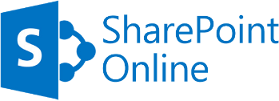
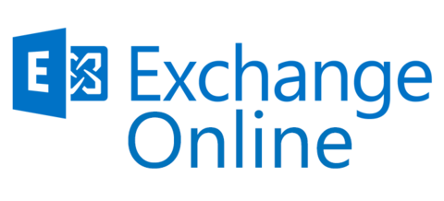
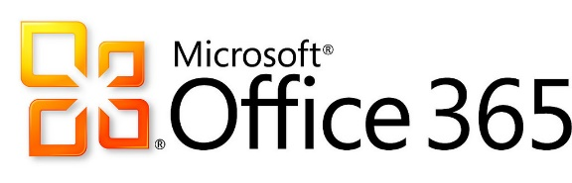

Cloud-Based Office 365 Support
Office 365 Integration
File Sharing & Storage
Collaboration
Notes:
Next month we’ll release complete support for scanning directly into Office 365 applications. This means when you scan a document and send via email, it won’t just show you as the sender, but it will in fact show up in your sent emails. Minor perhaps, but important. This also means whether collaborating via SharePoint or sharing documents via OneDrive, the paper trail is defined by the authenticator.

Slide 22

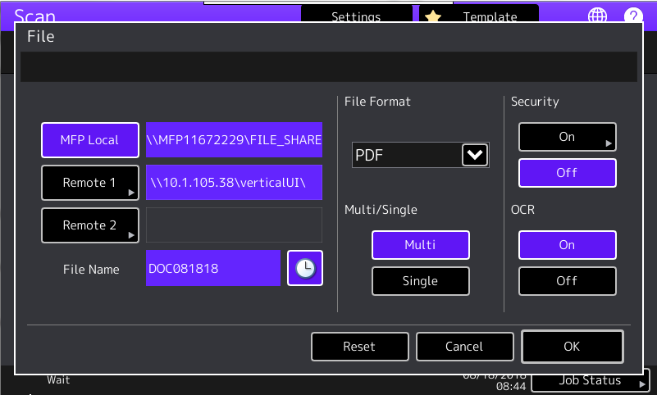

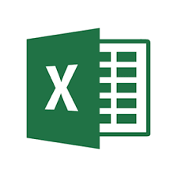
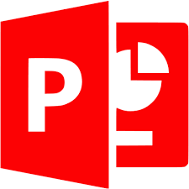
Embedded OCR
Make Documents Searchable
Acrobat
Convert to Popular Office Formats
Word
Excel
PowerPoint
Notes:
And we have an embedded Optical Character Recognition solution to make your scanned PDF documents searchable based on their content and not just a picture of the page. Or it can convert them to common Microsoft Office formats such as Word etc. on their way to one of these cloud-based file storage apps.
In October we’ll release connectors to enable scanning documents directly into Office 365. Basically we can do SharePoint, Exchange & OneDrive. These are all the repositories that serve the applications within Office 365.

Slide 23
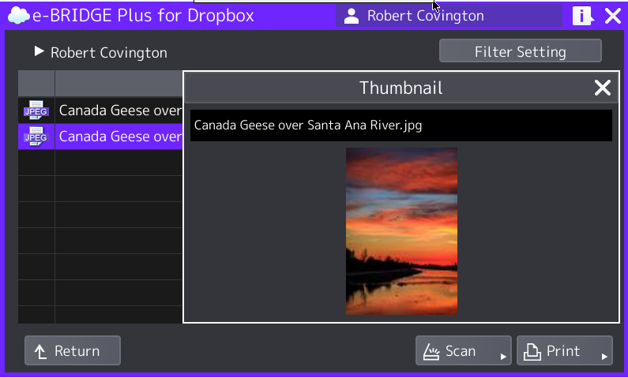
Printing from the Cloud
Use MFP as Offramp
10.1” Front Panel Provides Window
Printing on the Spot – at MFP
Notes:
Conversely if you want to print documents stored in these cloud apps, the large 10.1” Front panel provides an excellent window to them, and of course the MFP provides the printing capabilities right on the spot. It’s really a perfect marriage.
So here I’ve been talking about documents stored in the cloud and accessed from the front panel of the MFP and printed. Cool stuff.

Slide 24
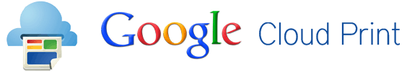
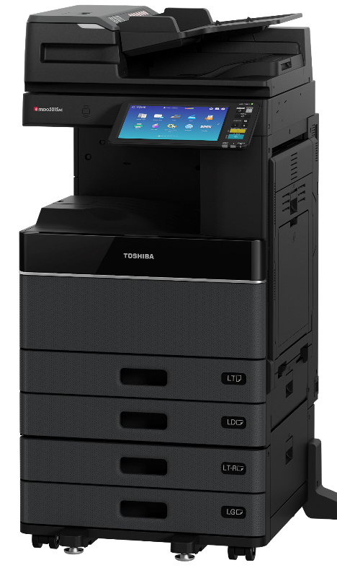
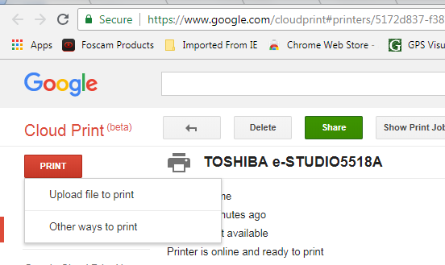
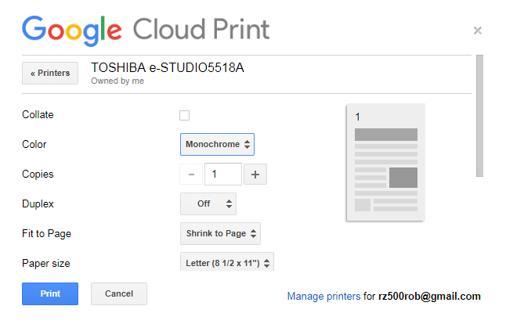
Print from Anywhere
Google Cloud Print
No Driver (Uses Google Browser)
Print from Mobile Device, PC, etc.
Notes:
But you can also print documents stored on the cloud or on your PC or mobile phone by sending the document to the MFP via the cloud. This is what Google Cloud Print does and all of these models will be Google Cloud Print Enabled. If your phone or PC is on the Web and your MFP is on a network that has Internet access you’re open to a World Wide Web of printing possibilities.

Slide 25

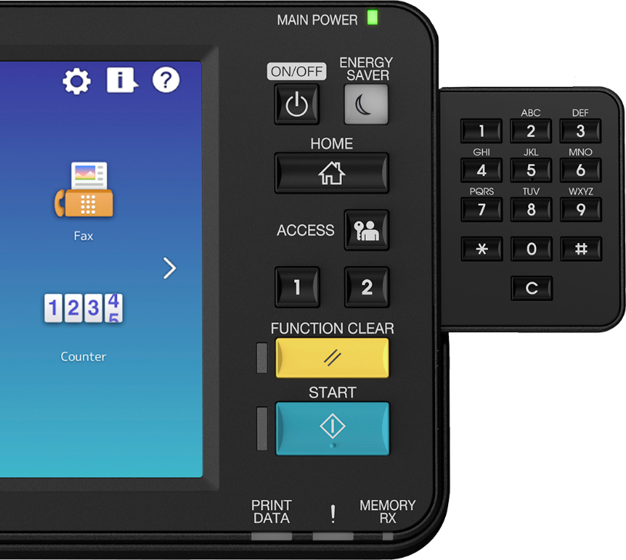
Cloud Fax
Reliable Faxing in VoIP Environment
Transparent to End-User
Keep Original Fax #s
Cloud & On-Premise Versions
Scalable
Notes:
There’s another area I want to talk about. It’s fax. Contrary to what many of you may think, fax is alive and well. Our fax connect rate is upwards of 60%. Our fax card, can be stacked to give you two lines if necessary. And we have a Fax Preview capability that allows you to view pages right on the front panel and decide whether or not you want to print them.
I wanted to point out though that fax is inherently analog technology, and there’s a migration to digital telephony that’s in full swing. Many businesses large and small are making the transition VoIP or Voice over Internet Protocol. Analog fax and digital telephone lines aren’t designed to work together, and they don’t.
We’ve partnered with XMedius that offers a very cost-effective solution that works even better than the original fax pioneers ever envisioned. To the fax user the experience is no different. They key in a number and press send. But under the hood, faxes are being sent and received as emails either to a server on the cloud or to an on-premise fax server where they’re converted back to analog and sent to their destination fax number. No more charges for phone lines and no busy signals. The advantages of digital are too numerous to cover in any depth here. I encourage you to visit our partner XMedius in the product fair. It’s just faxing – that works.

Slide 26
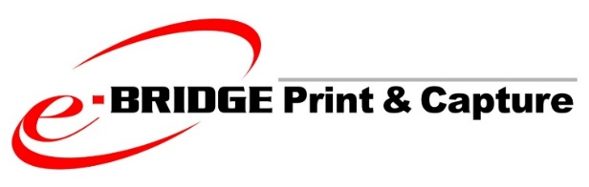


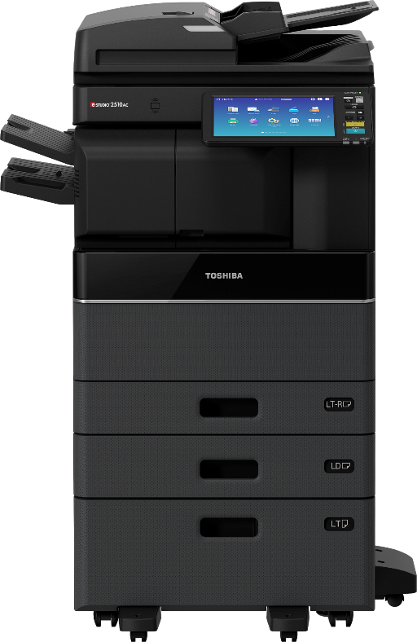
Mobile Device Support
AirPrint & Mopria Support
e-BRIDGE Print & Capture
More Document & Device Control
Scan Back to Mobile Device
Enables NFC Features on MFP
Scan-to & Print-from Cloud
Notes:
Our e-BRIDGE Print & Capture is the app. I encourage you to grab the latest version off iStore or Google’s Play Store. While our MFPs natively support Apple’s AirPrint & the Android Mopria protocols, our app gives you additional Toshiba-specific device control AND it lets you scan back to the phone – this is very cool.

Slide 27




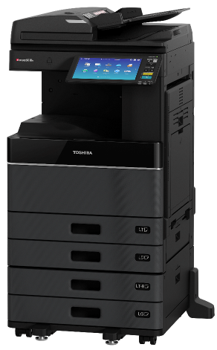
NFC Support
Android Mobile Device Authentication
No iOS Support
Print from Mobile Device
Instant Ad-hoc Connection
Notes:
These days many organizations like ours invoke secure access RFID card readers to get into the building. That same reader you swipe your badge over to get into the building is what we have for our MFPs.
Just like when you swipe your badge at the door it says you’re Robert, come on in, you can swipe that same badge at the MFP not only can the menu be personalized for you, but if you scan a document to email, you’re automatically identified as the sender. Your access to various functions of the MFP are controlled by your role within the organization.
Well the newest technology on your cellphone is NFC or Near Field Communication. Now instead of having to issue cards to users, like students at a school for instance, they can simply walk up to the MFP and the same reader in the MFP can interpret NFC to determine who you are and what rights on the MFP you have.
What’s more exciting is the Tap & Print capability. Now, users can have a document or photo on their phone that they want to print, walk up to an NFC enabled device, make the connection and print. It’s really that easy. Let me show you.
I encourage you to stop by our Product Fair and talk to the folks at Elatec, our preferred card reader vendor, about this exciting technology.
A couple points on NFC. Currently it’s only supported on Android Devices. Apple has it nailed down for ApplePay, but I hope to see this evolve.
Second, While NFC is a feature on your smart phone, using it requires an App.

Slide 28
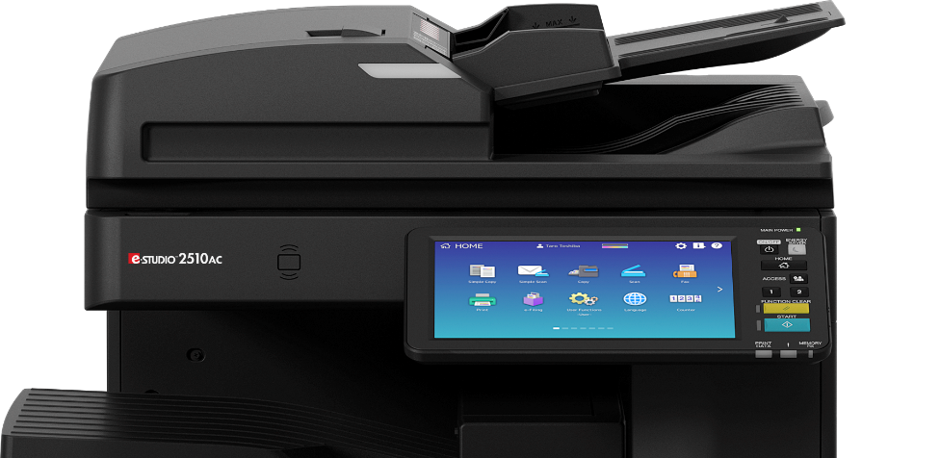

Security Features
Built-in Card Reader Pocket
Enables clean integration of card readers
Eliminates tampering
Card Reader hides inside machine!
(sold separately)

Slide 29

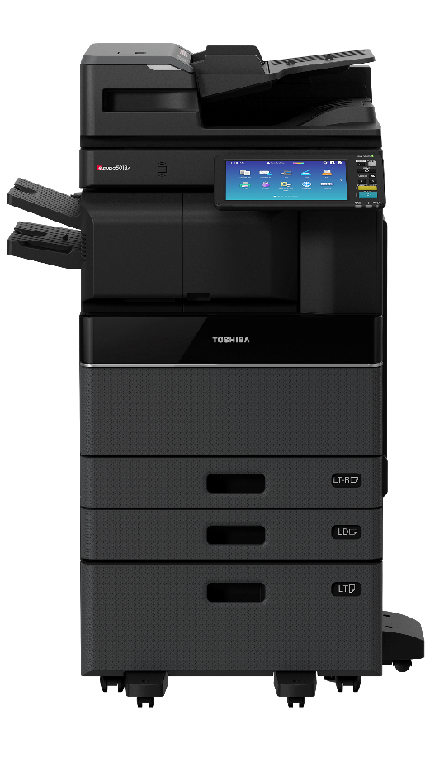

Security
Self Encrypting Drive
Automatic Data Invalidation
Data Overwrite - Exceeds DoD Standards
FIPS Validated HDD Available
Notes:
On the security front, we’ve got those bases covered too.
Toshiba makes their own hard drives. No other MFP manufacturer does. And we built the encryption right onto the drive. The Self-encrypting drive is a Toshiba exclusive.
And we have a FIPS validated drive. That means the drive, never mind the fact that everything on it is encrypted, is essentially tamper proof and we have proof – the FIPS Validated rating.

Slide 30


HCD-PP Certified
Hard Copy Device – Protection Profile
Digitized Documents are Safe
Product Tested Meets Rigorous Security Assurance Requirements
Notes:
These newest MFPs from Toshiba are HCD-PP or Hard Copy Device Protection Profile certified, it’s the latest Security Certification to come out of the NIAP (National Information Assurance Partnership) and Common Criteria Test Laboratories. HCD-PP ensures users dealing with digitized documents – physical documents being scanned, copied or faxed, or digital documents being printed – that the MFP they’re using meets rigorous Security Assurance Requirements and their documents while in “digital” form are safe within the MFP.
Whether it’s FIPS or HCD-PP, or any other security concern you may have, we’ve got you covered. We have major account customers in government and financial sectors and they demand the latest and greatest and we rise to the challenge. I’ve personally worked with these customers to make sure we can meet their needs.

Slide 31




Environment
RoHS Compliant
Lower TEC Value
EPEAT Registered
Gold Status
ENERGY STAR V2.0
V3.0 Ready
Notes:
Looking at the environment, Toshiba is probably the highest profile manufacturer in the industry. We’re not the biggest MFP manufacturer, but undoubtedly, we’re the largest company. And when you’re big you’ve got to get it right because you bet people are looking. But our culture is one of environmental sensitivity. It’s the right thing to do.
This is why only a company like Toshiba would come out with a product with erasable toner. Only Toshiba would demand that all products it manufactures would be RoHS compliant. That means hazardous substances like chromium and lead aren’t in the products we sell.
These new models are ePEAT Gold Registered too. Electronic Products Environmental Assessment Tool. This is the highest rating and it means that when environmentally conscious buyers want to select an environmentally responsible office product, these models will be listed among the highest rated products
Our products are Energy Star 2.0 rated, and when 3.0 comes out next year, we’ll be ready to step right into it. I’ve seen some competitors already claiming a 3.0 rating, implying they’re the only ones that have it. Well they don’t because it’s not out yet, however these models were designed with that in mind. Even our Intel Atom multicore processor, while boasting of its multitasking horsepower, is recognized for its energy efficiency.

Slide 32

Summary
Contemporary Fresh Look
Serves mid-size workgroups
Powerful specs
Convenient workflow-enhancing features
Secure & environmentally friendly
Configurable to meet user’s needs

Slide 33
THANK YOU.

